Slide 1
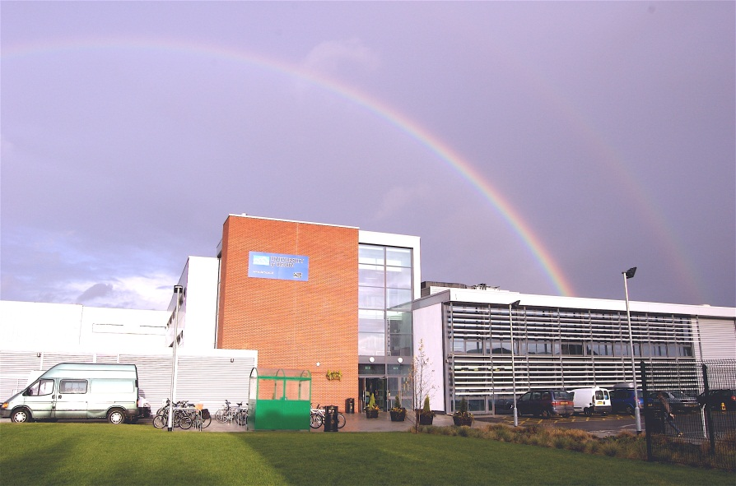
INDEPENDENT ENGINEERING SCHOLARSHIP
(7EJ998)
Module Leader: Dr Ahmad Kharaz
Email: A.kharaz@derby.ac.uk
Tel: 01332 593204
Room: MS208

Slide 2
The Independent Engineering Scholarship
The Independent Engineering Scholarship carries 60 credit (1/3 of you MSc) and forms an essential, integral and substantial part of your Master’s degree. It will provide you with an opportunity to apply and enhance the knowledge and intellectual skills gained during your programme and allows you to develop your specialist skills in an area of your choice.

Slide 3
Key steps
Choose a project
Submit a proposal
Present and demonstrate results
Submit a final report
Submit any artefacts

Slide 4
Aim of the Project
The aim is to develop your ability to work independently, in a chosen topic, using appropriate research and design concepts, and analytical, test, measurement and evaluation techniques, in order to produce a finished artefact or product.
You will be expected not merely to collect, analyse and apply information, but also to exhibit other skills such as the ability to plan, manage and produce a significant technical piece of work.

Slide 5
Module Learning Outcomes
Plan and initiate a major piece of engineering scholarship, demonstrating innovation, application of research methods, and advanced engineering practice.
Work on own initiative, developing and applying techniques of scientific enquiry, project management, analysis, experimentation, research, and problem solving.
Reflect upon the work undertaken, placing the results into the context of theories and practice, and the original plan for the study.
Present and discuss findings in depth, in spoken and written form, clearly communicating the critical issues and key features.

Slide 6
Steps in Project Allocation
Supervisors propose projects on module resources or by individual discussion with students
You can propose a project yourself
Students arrange meetings with potential supervisors
Student indicate supervisor preference on proposal
Module leader allocates projects to students

Slide 7
Industrial Projects
We welcome industry based projects
Must be approved by module leader or programme leader

Slide 8
Timeline
Preparatory workshops to explore, guidance on the proposal, the academic standard, working style (Induction and Jan 2017).
Students will be given the opportunity to draft project proposals, and receive formative feedback on these (Jan/Feb 2017).
Submit the final project proposal (6 Feb 2017).
Proposal marked by supervisor and feedback given (Feb 2017)
Begin working on project – meet regularly with tutor (Feb 2017)
Interim Presentation (week commencing 13th March 2017).
Write final project report and submit (19th May 2017).
A viva voce presentation (week commencing 29th May 2017).

Slide 9
Assessment
Formative assessment
Feedback will be given following the development of a draft project plan and an ethical approval form containing a preliminary literature review.
Summative Assessment
CW1: 20% Weighting: Learning Outcome 1 to be assessed.
1. A written proposal defining the project.
2. A viva voce progress presentation of up to 15 minutes, with 15 minutes of questions. .

Slide 10
Assessment
CW2: 80% Weighting: Learning Outcomes 2, 3, 4 to be assessed.
This coursework is made up of two components:
1. A dissertation, of not more than 20,000 words.
2. A viva voce presentation of up to 20 minutes, followed by a question and answer session of the same time. This will be video recorded for internal moderation purposes.
The dissertation is weighted at 80% of CW2.

Slide 11
The interim presentation
The interim presentation is an opportunity for you to explain your work to a group of your lecturers and to your fellow students.
The presentation should include:
1. Project specification with a project plan.
2. A survey of the research that is related to your project.
3. Progress made to date including any difficulties encountered.
4. A plan of how you intend to proceed next
Spend good quality time on preparing it and use it to build up information for the final dissertation.

Slide 12
Very Important Link
Continuously access module course resources for announcements and essential information related to your project.

Slide 13
What you are required to submit
Proposal:
1. Written proposal defining the project
2. Completed Risk Assessment and Ethical
(complete the forms provided)
Dissertation:
Two hard copies of your report
An electronic copy through e-submission

Slide 14
Essentials for Success
The followings are essentials for a successful project:
Meet your supervisor regularly
Work steadily
Make a habit of writing notes on what you read and do
Read related research articles and make a note of their sources
Seek advice early if you have difficulties

Slide 15
Avoid Plagiarism
Remember: all the contents of your project MUST be either original or referenced.
Neither you, nor anyone else, may have submitted this particular work for examination to this or any other institution (most institutions now submit to central databases precisely for this purpose)

